Slide 1
Movie Recommender System
By- Trisha Roy
PROJECT MENTOR:
PROF. ARNAB CHAKRABORTY

Slide 2
CONTENTS
Project Objective & Scope
Data Description
Methodology
Data Acquisition
Data Preprocessing
Feature Engineering
Model Used
Inference
Future Scope Of Improvements

Slide 3
PROJECT OBJECTIVE & SCOPE
Objective:
Given: A movies database taken from Kaggle dataset.
Goal: To recommend five movies which are similar from the movie provided by the user using NLP.
Finally: Apply on the test dataset.
Scope:
It is a useful project as we have used feature engineering techniques, such as Bag of Words, to extract meaningful information from movie descriptions, reviews, or user ratings. The effectiveness of these techniques in capturing the essence of movies and users' preferences can be a focal point.
Once the recommendation system is developed transforming it into a website and ensuring its smooth operation is crucial.

Slide 4
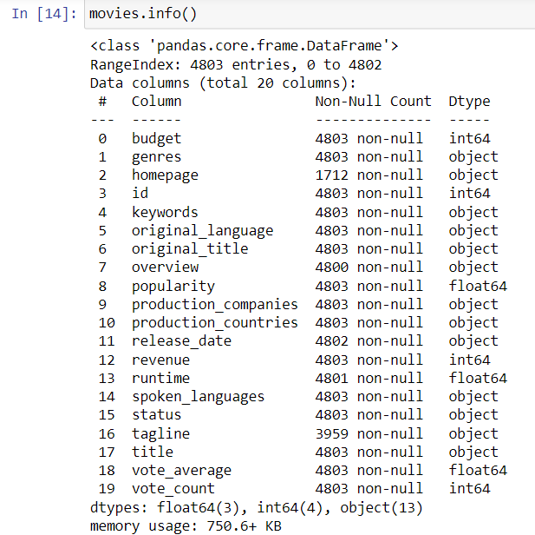
DATA DESCRIPTION
There were two different datasets
Movies.csv

Slide 5
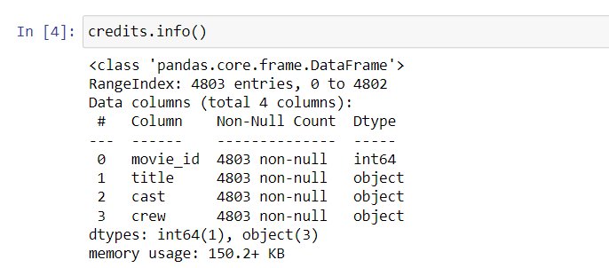
Credits.csv
Later on we combine both of them to work on single dataset.

Slide 6
METHODOLOGY
Data Acquisition
Text Preprocessing
Feature Engineering
Model Building
Applying the Model on Dataset
Forming A web dashboard to show the implementation

Slide 7
Data Acquisition
As I used TMDB dataset from Kaggle for this movie recommendation system, the data acquisition process typically involves the following steps:
Download the Dataset
Understand the Dataset
Load the Dataset into your programming environment.

Slide 8
Data Preprocessing
Removal of null and duplicate values.
Removal of unnecessary columns and storing the data in required form.
Text Preprocessing:
Tokenization
Lowercasing
Stop word removal
Stemming

Slide 9
Feature Engineering
Feature engineering is the process of transforming raw data into meaningful features that can be used as input for machine learning algorithms. It involves selecting, creating, and transforming features to improve the performance of a machine learning model
One common feature engineering technique used in content-based recommendation systems is the Bag of Words (BoW) approach. The Bag of Words technique represents text documents as numerical vectors, disregarding the order and structure of the words in the document. It focuses solely on the presence or absence of words and their frequencies.
The Bag of Words technique provides a way to represent textual information in a numerical format suitable for machine learning algorithms. It allows the content-based recommendation system to find similarities between movies based on the words present in their descriptions, enabling personalized recommendations for users with similar movie preferences.

Slide 10
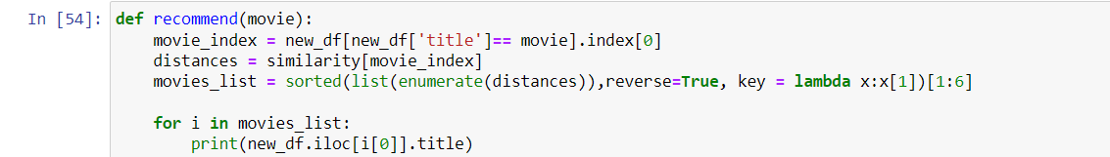
Model Used
I have created my own movie recommendation model using feature engineering. Here’s a description of the features of model:
Movie Similarity: This model calculates the similarity between movies based on their descriptions. It uses a similarity matrix called similarity, which likely represents the pairwise similarity scores between movies.
Input: The recommend function takes a movie title as inpt. This allow users to specify a movie for which they want to receive recommendations.
Movie Index: Your model uses the input movie title to find the corresponding movie index in the dataset.

Slide 11
Distance Calculation: The model then retrieves the similarity scores of the input movie with all other movies from the similarity matrix.
Top Similar Movies: The model identifies the top similar movies to the input movie based on the similarity scores. It sorts the movies in descending order of similarity, excluding the input movie itself, and selects the top 5 movies as recommendations.
Recommendation Display: The model prints the titles of the recommended movie.
Overall this model utilizes a content-based recommendation approach that relies on the similarity of movie descriptions to make recommendations. By comparing the input movie’s description with the descriptions of other movies, it identifies the most similar movies and presents them as recommendations to users.

Slide 12
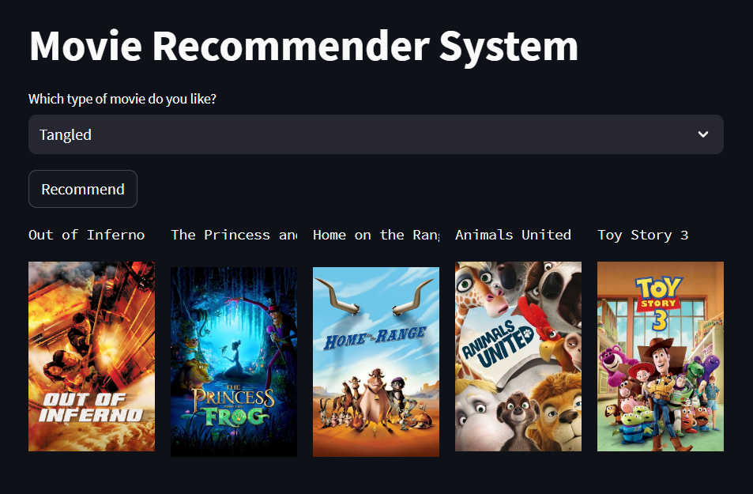
INFERENCE
After applying the model on the given dataset I made a dashboard using streamlit library. The model which I have created is giving the following results.

Slide 13
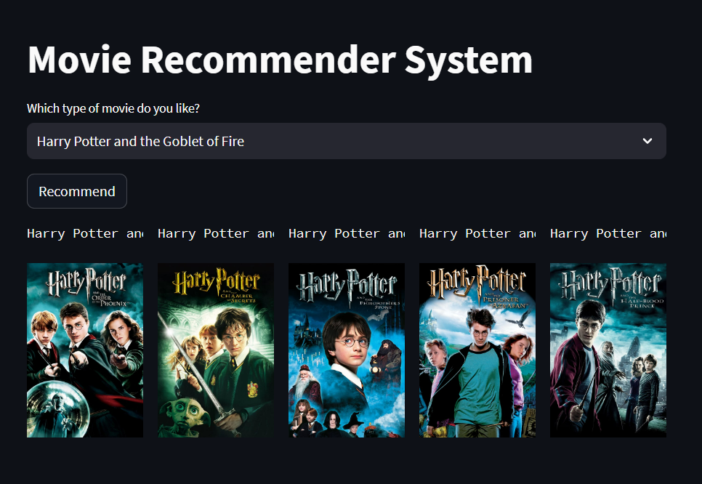

Slide 15
FUTURE SCOPE OF IMPROVEMENTS
Here are few potential areas for future improvements in movie recommendation project.
Advanced Similarity Measures: While the current model likely uses a predefined similarity matrix, you can explore other techniques such as TF-IDF (Term Frequency-Inverse Document Frequency) or Word Embeddings (e.g., Word2Vec, GloVe) to capture more nuanced relationships between movies.
Incorporate User Feedback: To enhance the recommendation system, consider integrating mechanisms for collecting and incorporating user ratings, reviews, or implicit feedback (e.g., user interactions, watch history). This can help personalize the recommendations and improve their accuracy.

Slide 16
Genre-specific Recommendations: Instead of solely relying on overall movie descriptions, you can extract genre information and incorporate it into the recommendation process. This would allow users to receive recommendations tailored to their preferred genres or explore movies across different genres.
Hybrid Recommender Systems: Hybrid recommender systems leverage both content-based and collaborative filtering approaches to provide more accurate and diverse recommendations.
User Interface and Visualization: Incorporating interactive visualizations, movie posters, trailers, or additional metadata to provide a more engaging and informative user experience.

Slide 17
THANK YOU
Lovely Professional University
Under- Fifth force

